Slide 1
Employee Data Analysis using Excel
STUDENT NAME: R.REENARAJ
REGISTER NO: 122202074
DEPARTMENT: CORPORATE SECRETARYSHIP
COLLEGE : ANNA ADARSH COLLEGE FOR WOMEN

Slide 2
PROJECT TITLE
Employee Performance Analysis using Excel

Slide 3


AGENDA
Problem Statement
Project Overview
End Users
Our Solution and Proposition
Dataset Description
Modelling Approach
Results and Discussion
Conclusion
3/21/2024 Annual Review

Slide 4

PROBLEM STATEMENT
The goal of this project is to analyze employee data to gain insights into workforce demographics, performance metrics, and overall company productivity. The analysis aims to identify trends, patterns, and areas for improvement in employee management.

Slide 5

PROJECT OVERVIEW
•To analyze and optimise the performance of the employees by evaluating the key metrics such as employee ID, Business unit, Employee status, Performance Level, etc.

Slide 6

WHO ARE THE END USERS?
Employers Employees Organisation

Slide 7

OUR SOLUTION AND ITS VALUE PROPOSITION
Filtering: To find the missing data
Chart: To get an graphical representation
Pivot table: To summarize the data.
Conditional techniques: Used to identify the missing data.

Slide 8
Dataset Description
Employee Dataset: kaggle.
Total: 26 Features.
Used: 9 features.
Employee ID.
2. First name.
3. Last Name.
4. Business unit.
5. Employee type.
6. Gender.
7. Performance score.
8. Current employee rating.
9. Performance Level.

Slide 9

THE "WOW" IN OUR SOLUTION
FORMULA:=IF(Z8>=4,"VERY HIGH",IF(Z8>=3,"MEDIUM",IF(Z8<=2, "LOW")))Conditional Formatting:The conditional formatting is used to identify the missing data in a cell, highlight the missing cell and also to remove the missing cell.
3/21/2024 Annual Review
9

Slide 10
MODELLING
Data screening: Data screening is the process of reviewing and cleaning data toidentify and correct errors, inconsistencies, or missing values.
Data Cleaning: Data cleaning is the process of detecting and correcting errors, inconsistencies, and inaccuracies in a dataset
Data Formulation: Data formulation refers to the process of organizing and structuring raw data into a defined format or model that can be easily analyzed or used for specific purposes
Pivot table creation: Pivot table creation is the process of summarizing, analyzing, and organizing data in a spreadsheet, typically in Excel or Google Sheets.
Graphical representation: A graphical representation is a visual way of presenting data or information, making it easier to understand and interpret. It can include various forms such as charts, graphs, diagrams, maps, and images. The purpose of a graphical representation is to communicate complex information clearly and effectively through visuals rather than text alone.
10

Slide 11
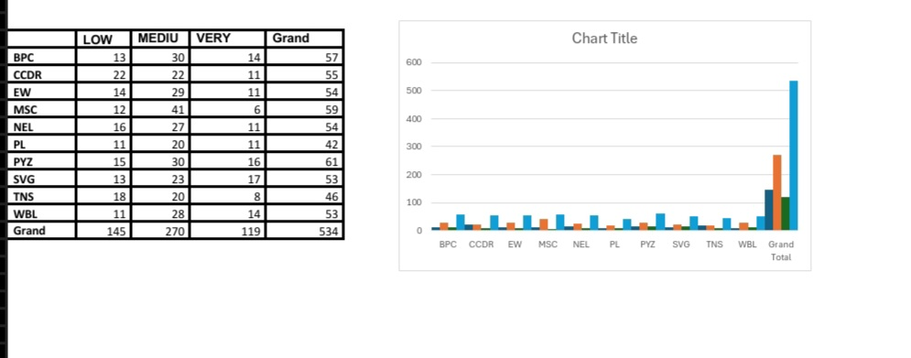
RESULTS
11

Slide 12
conclusion
The project helps firms track employee performance efficiently, allowing managers to quickly identify top performers and those needing support. It aids in optimizing workforce allocation by analyzing trends in employment. types and performance levels. Day-to-day operations are simplified through better data organization and visualization, improving reporting and decision-making. The insights enable proactive management of employee development and retention strategies. This ultimately enhances productivity and organizational effectiveness.

